Slide 1



HYATT REGENCY GURGAON

Slide 2
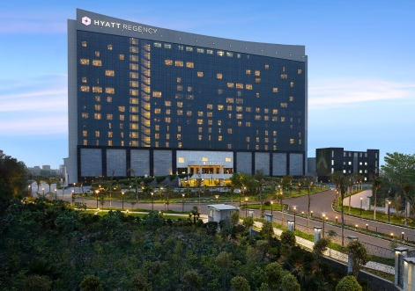
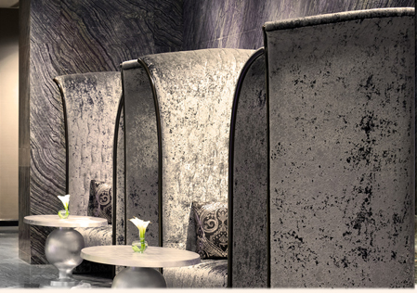
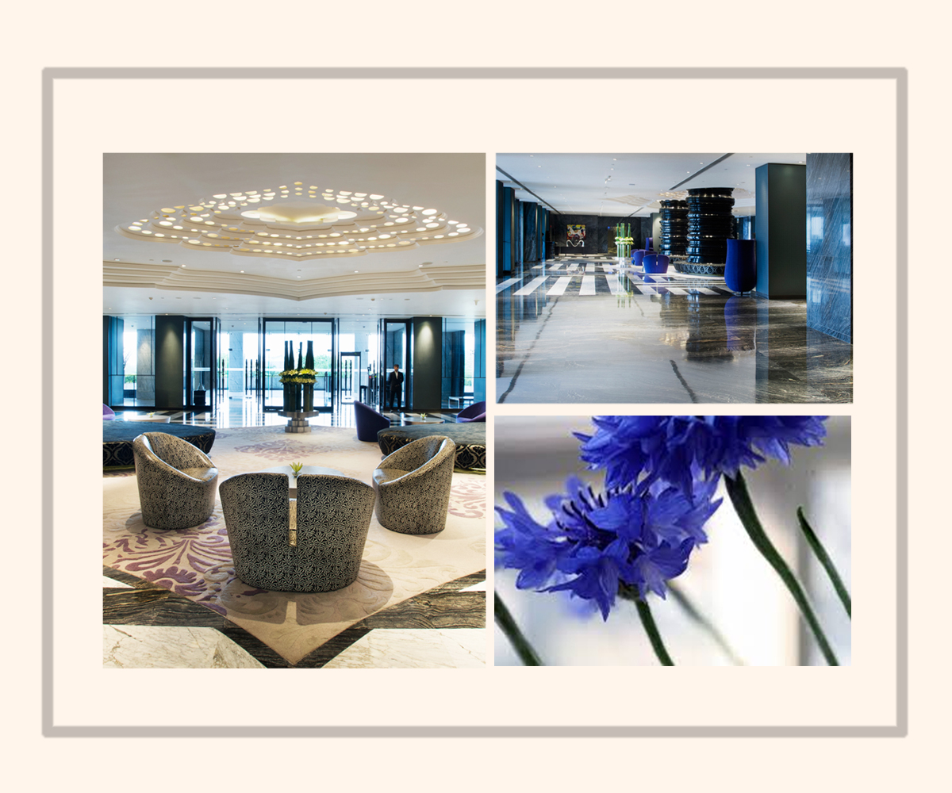
The Largest Convention Hotel in Gurgaon Located in the rapidly expanding business and residential city of Gurgaon in India’s National Capital Region (NCR). Hyatt Regency Gurgaon has the largest meetings and events space and caters to large multi-purpose MICE (meetings, incentives, conferences and exhibitions) from across the country.
“Best MICE Hotel–North India” at Exhibition Excellence Awards 2016
“Best Convention Hotel–North India“ at Indian Hospitality Awards 2015
“Best Wedding Hotel” at Great Indian Weddings Awards 2015
“Best South Indian Fine Dining Restaurant” at Times Food Guide Awards 2016
“Best New Awadhi Restaurant” by Time Out Food Awards 2014

Slide 3

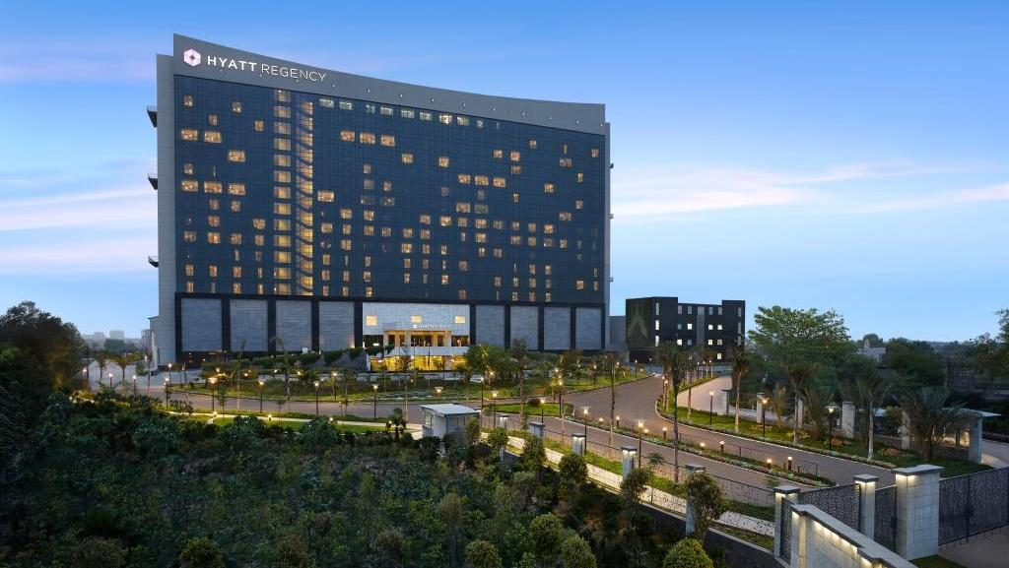
Hyatt Regency Gurgaon – Largest Convention hotel in the city

Slide 4
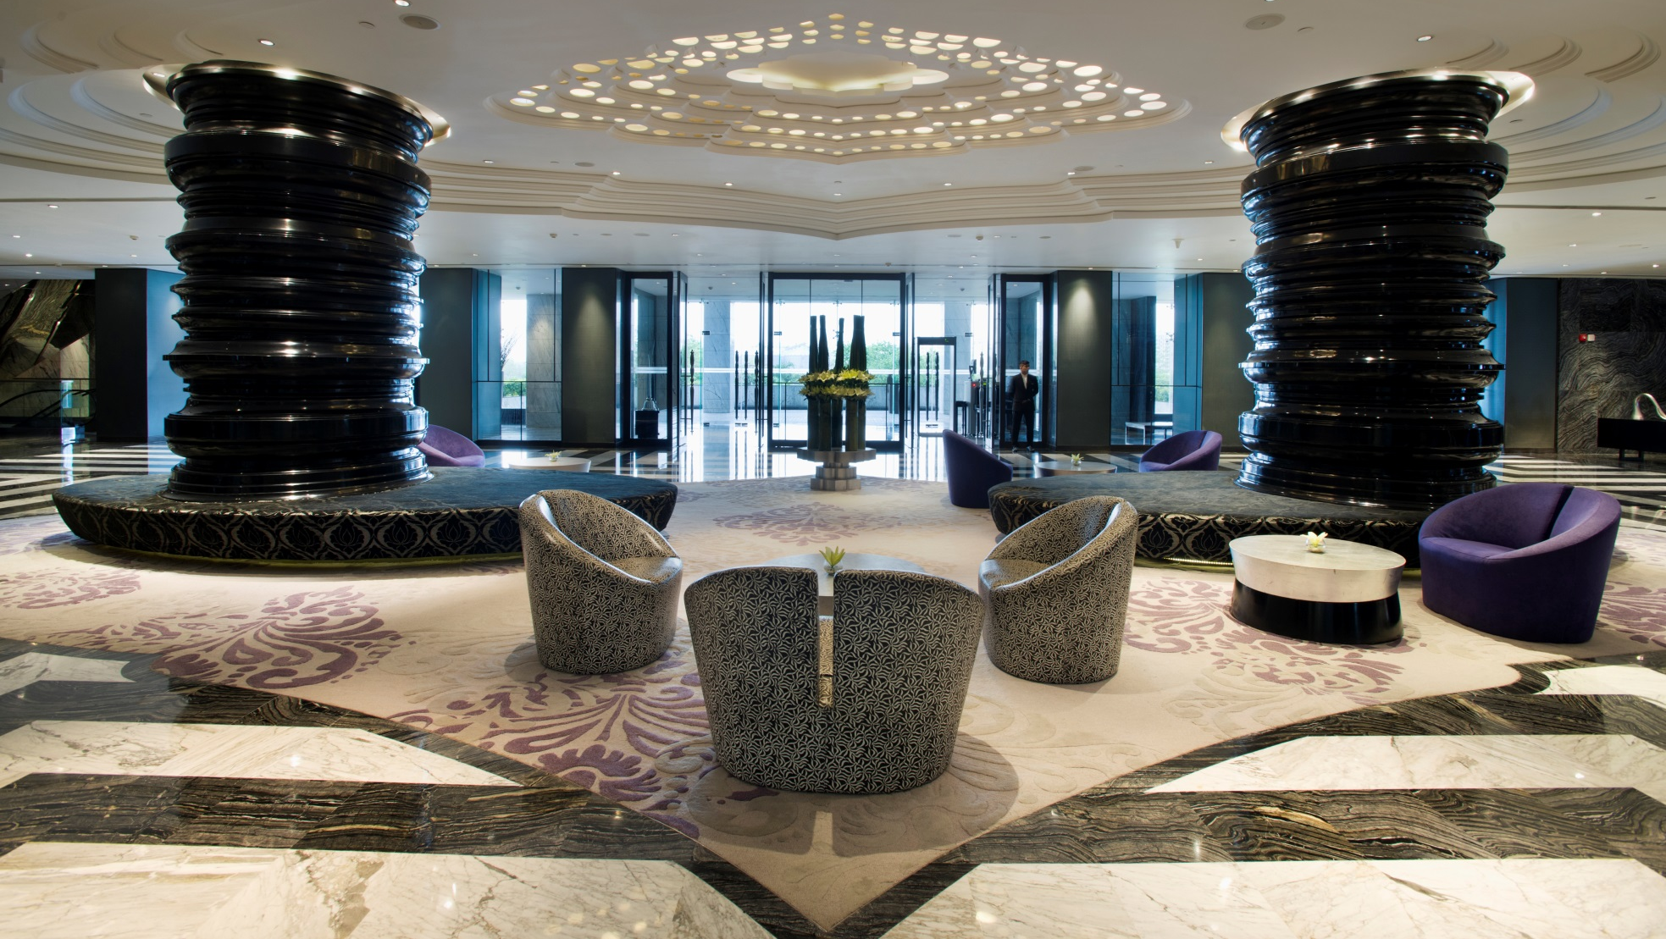
Hotel Lobby - Great place to meet & greet.

Slide 5
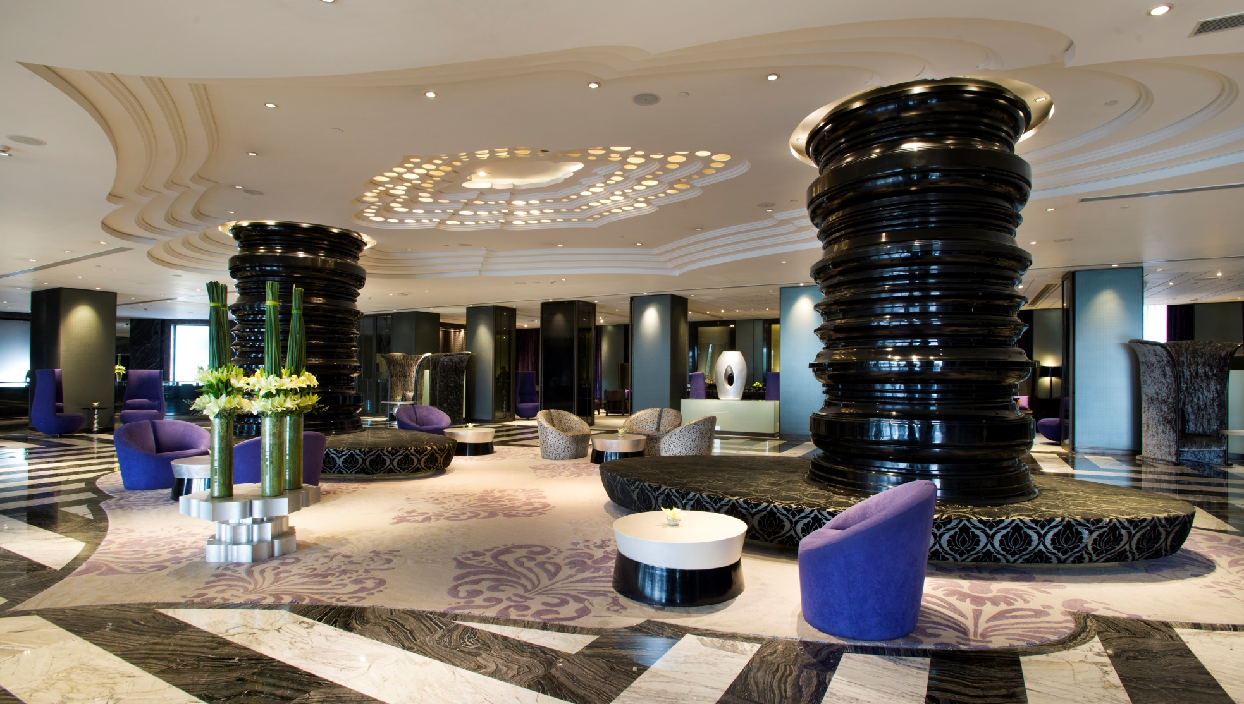
Hotel Lobby - Great place to meet & greet.

Slide 6
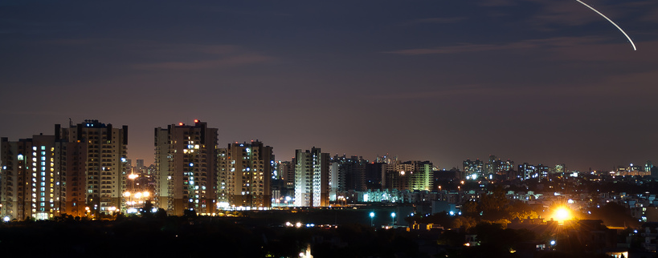
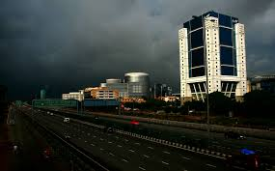
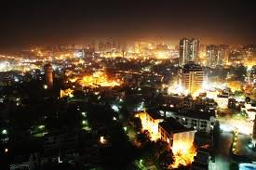
Location
Strategically located off the Delhi-Jaipur National Highway 8, adjacent to the KM 42 Toll Plaza. Hyatt Regency Gurgaon is the ideal hotel for business travellers to Gurgaon
Easy access from the National Highway 8, The hotel is conveniently located within thirty minutes from the Indira Gandhi International Airport and is just fifteen minutes drive from Gurgaon city centre .
Our urban, contemporary hotel offers a 5 star luxury gateway to Gurgaon, dubbed as one of India’s “fastest growing commercial centres”.
Situated in between the commercial hub and industrial zone of Gurgaon, Manesar & Bhiwadi.
The location of the property makes it an ideal base for tourists covering the entire ‘Golden Triangle’ of Delhi, Agra & Jaipur.

Slide 7
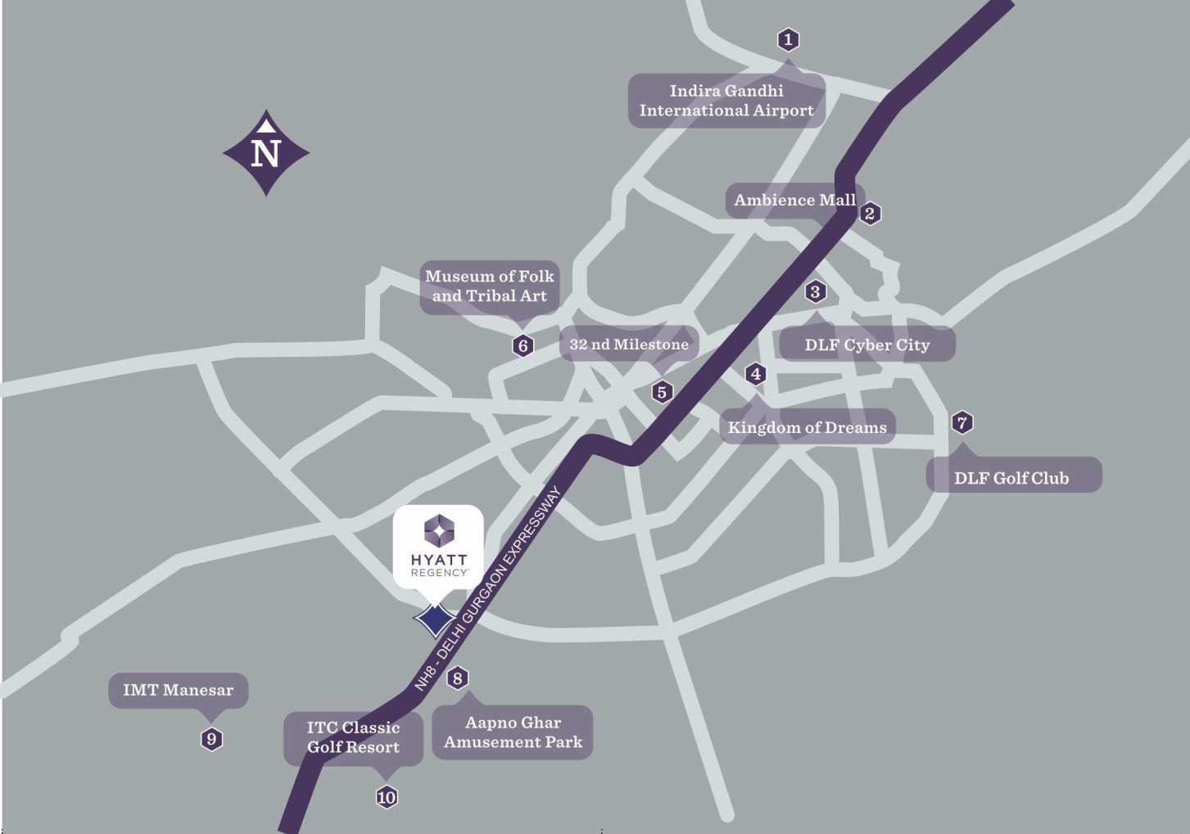
Located on the National Expressway with easy access from Delhi NCR & en-route to Jaipur city. The hotel is conveniently located within thirty minutes from the Indira Gandhi International Airport & is just fifteen minutes drive from Gurgaon city centre

Slide 8



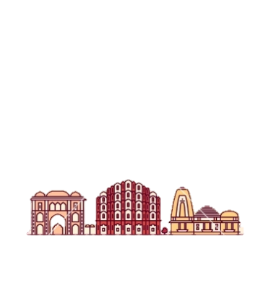
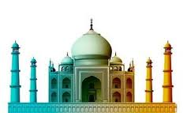
HYATT REGENCY GURGAON :
THE GATEWAY TO THE GOLDEN TRIANGLE
Hyatt Regency Gurgaon
to Delhi
40 kms – 55 minutes
NEW DELHI
Hyatt Regency Gurgaon
to IGI
25 kms – 35 minutes
GURGAON
Hyatt Regency Gurgaon
to IFFCO Chowk
143 kms – 18 minutes
Hyatt Regency Gurgaon to Jaipur
234 Kms – 3.16 hours
Delhi to Agra
234 kms 2hours 47 minutes
JAIPUR
AGRA
Jaipur to Taj Mahal
243 kms – 4 hours

Slide 9
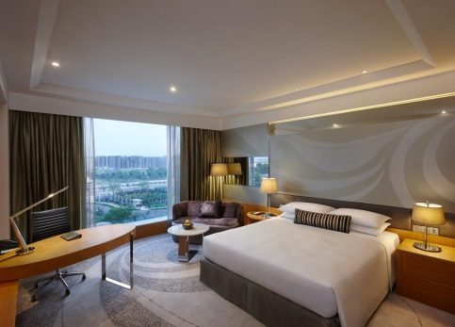
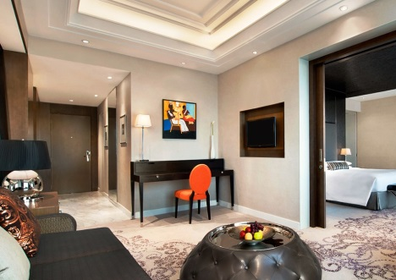
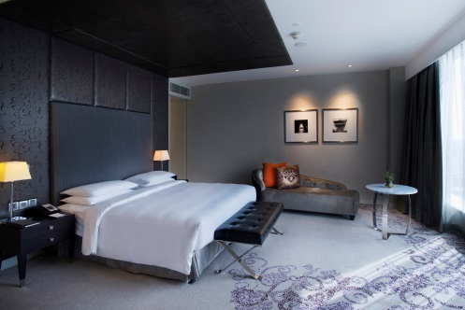
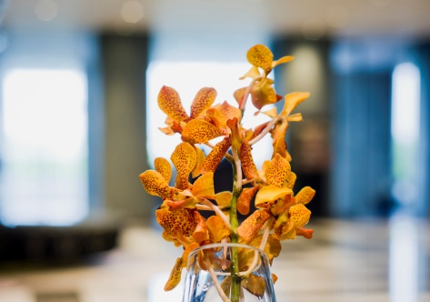
Spacious Rooms. Comfortable Stay.
451 well-appointed, spacious guestrooms (44 sq mts.) including 37 luxurious suites (starting from 88 sq mts.) are thoughtfully designed to contribute to the stylish & comfortable ambience.
Four specially designated Regency Club floors for the club guests include a Regency Club Lounge which offers a complimentary buffet breakfast and evening cocktails. The Regency Club’s other services include private check-in and check-out facilities, limited access to a private boardroom.
Room configuration includes :
174 King Room Standard
165 Twin Room Standard
38 Club King Rooms
37 Club Twin Rooms
35 Regency King Suite
01 Regency Executive Suite
01 Presidential Suite

Slide 10

HOTEL FACTS

Slide 11
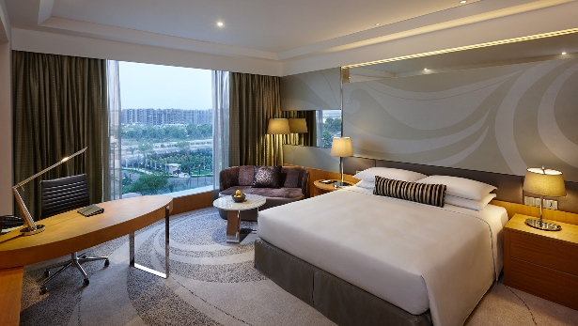
Standard King Room - Spacious guestrooms starting from 44 sq. meter onwards

Slide 12
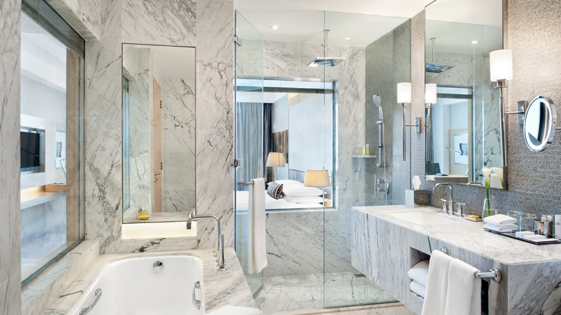
King Room Bathroom - Lavish marble bathrooms are designed overlooking the room with facilities including a rain shower cabin, soaking tub and a wide range of bathroom amenities.

Slide 13
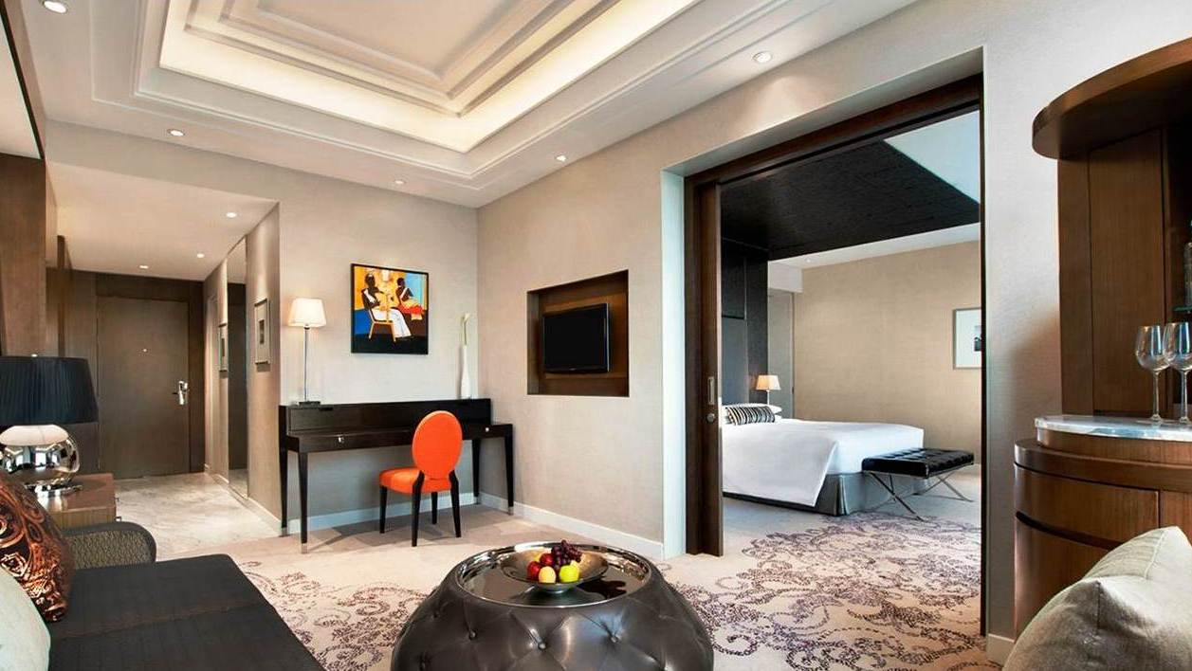
Regency King Suites - 37 luxurious suites thoughtfully designed to contribute to the stylish and comfortable ambience.

Slide 14

Regency King Suites - 37 luxurious suites thoughtfully designed to contribute to the stylish & comfortable ambience.

Slide 15
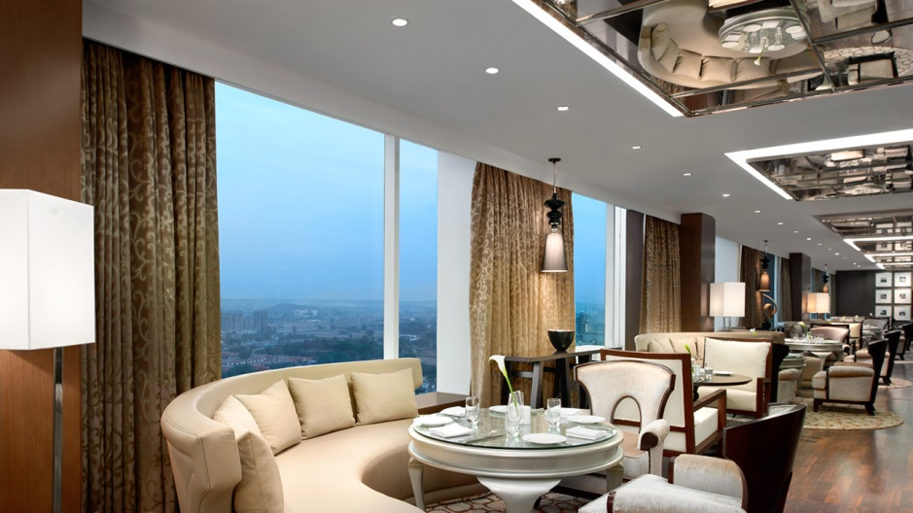
Exclusive Regency Club Lounge

Slide 16
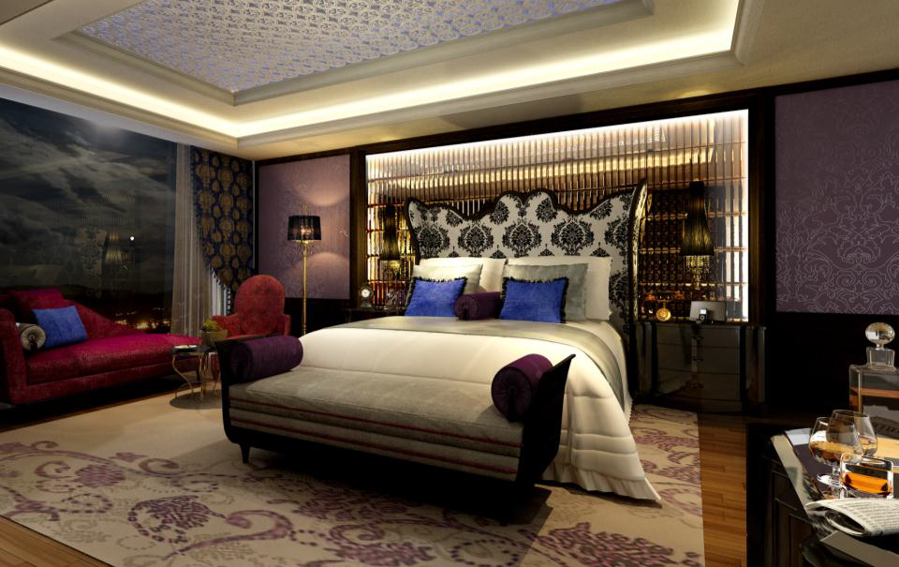
Presidential Suite - Upscale, contemporary decor welcomes guests to this 264-square-metre top-floor, two-bedroom suite, which features one king and two twin beds, plus separate living and dining rooms

Slide 17
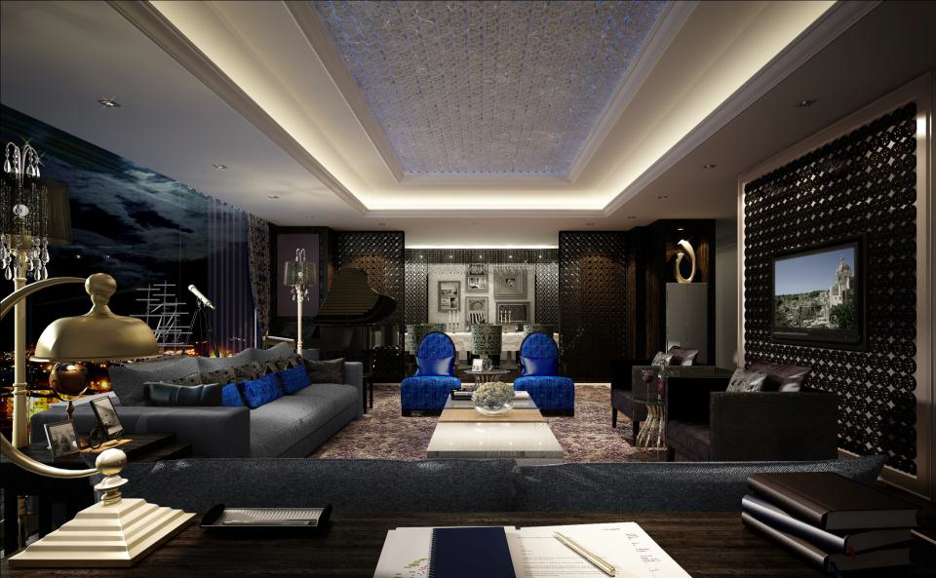
Presidential Suite – Living room

Slide 18
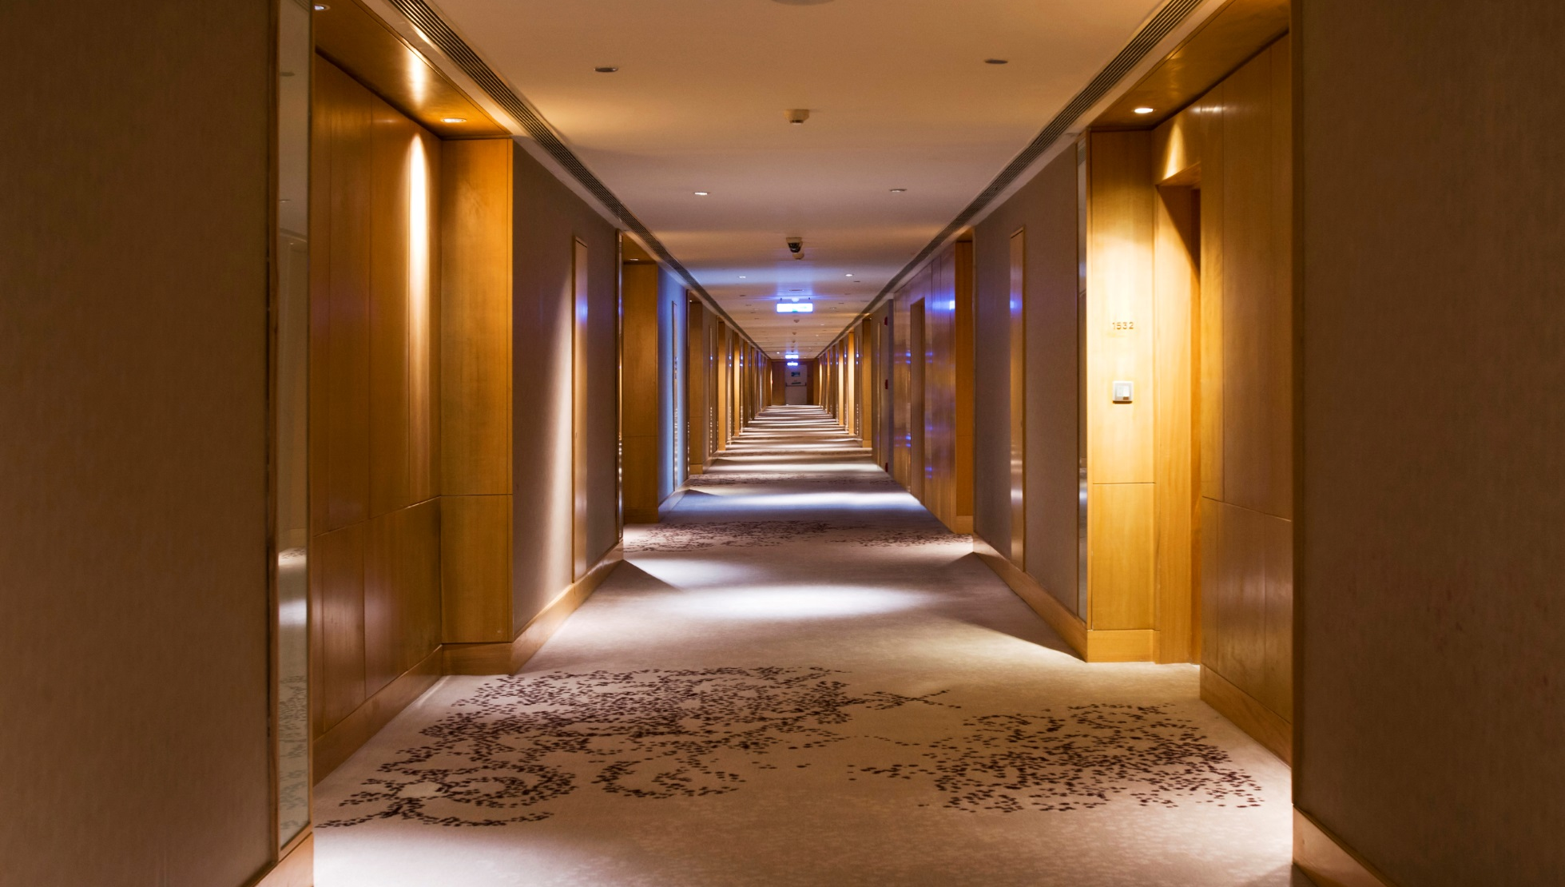
Guest Floor Corridor

Slide 19

FOOD &
BEVERAGES

Slide 20
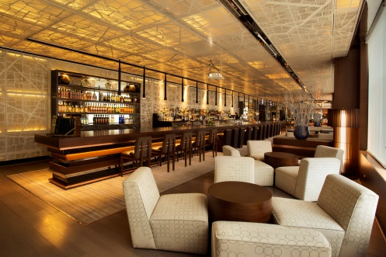
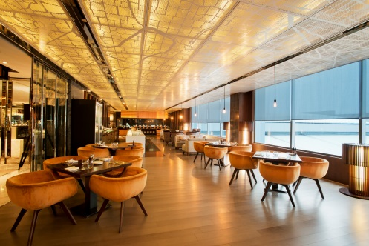
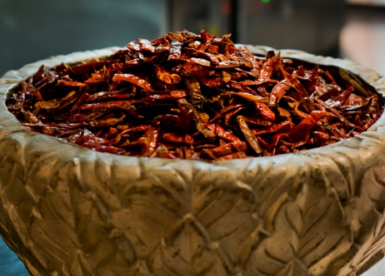
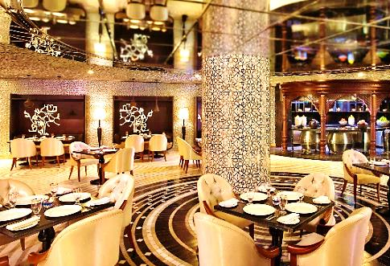
Experience a wide array of authentic Indian, Japanese, Mediterranean, Western & Asian cuisines that take you to an unparalleled gastronomical treat through different restaurants & bars at Hyatt Regency Gurgaon.
Lavana — signature restaurant offering a delectable selection of Awadhi specialties
The Lounge — the ideal venue for a quick breakfast, a casual business meeting cum lunch or early evening snacks and drinks
Kitchen District — interactive kitchens serving Asian, Indian and Western cuisines as well as homemade desserts and ice creams. Awarded “Best South Indian Fine Dining Restaurant” at Times Food guide Awards 2016
The Long Bar — a stylish and intimate bar featuring an eclectic selection of premium sprits, a range of new and old world wines and innovative cocktails created by engaging and skilful bartenders

Slide 21
Kitchen District - Vibrant and warm, the brand new Kitchen District, offers an exclusive dining experience
Awarded “Best South Indian Fine Dining Restaurant” at Times Food guide Awards 2016

Slide 22
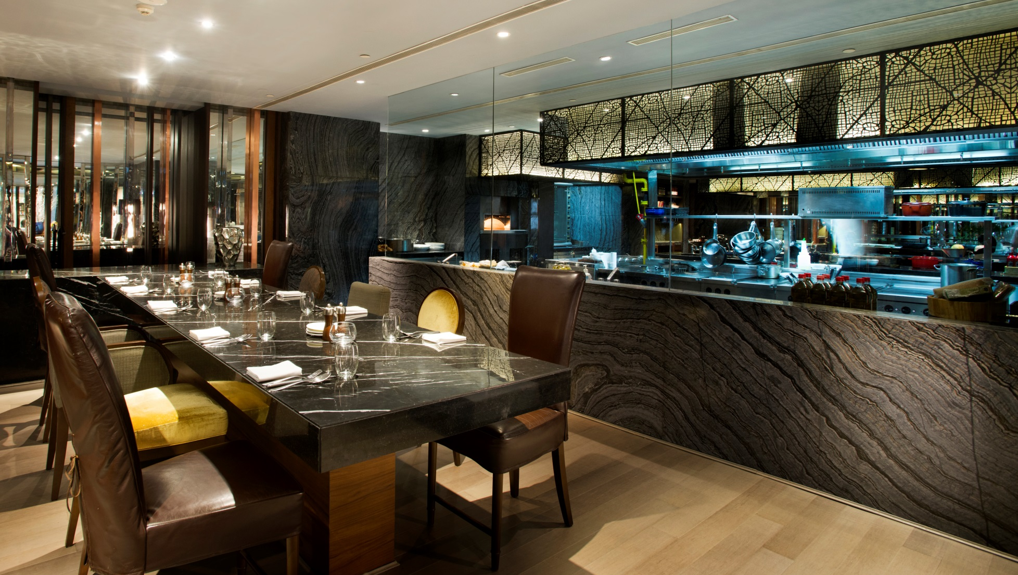
Kitchen District - Stylish Private sitting area
Awarded “Best South Indian Fine Dining Restaurant” at Times Food guide Awards 2016

Slide 23
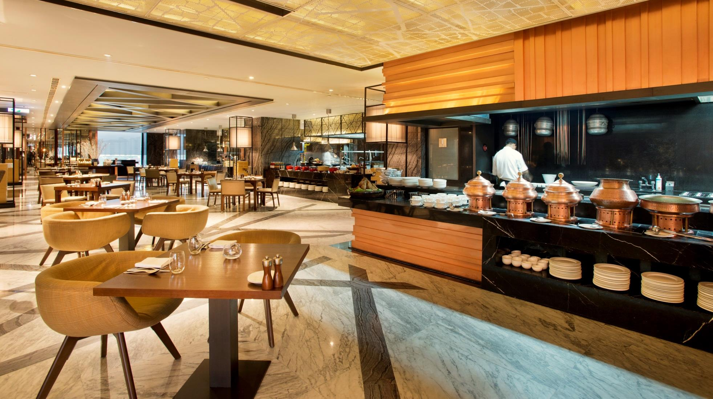
Kitchen District - With five standalone kitchens designed to offer distinctive cuisines yet coexisting in perfect harmony to form a singular culinary district.
Awarded “Best South Indian Fine Dining Restaurant” at Times Food guide Awards 2016

Slide 24

The Long Bar - A stylish and casual 60 feet long bar featuring an eclectic selection of the finest spirits, new and old world wines & a range of innovative cocktails created by the engaging and skilful bartenders.

Slide 25
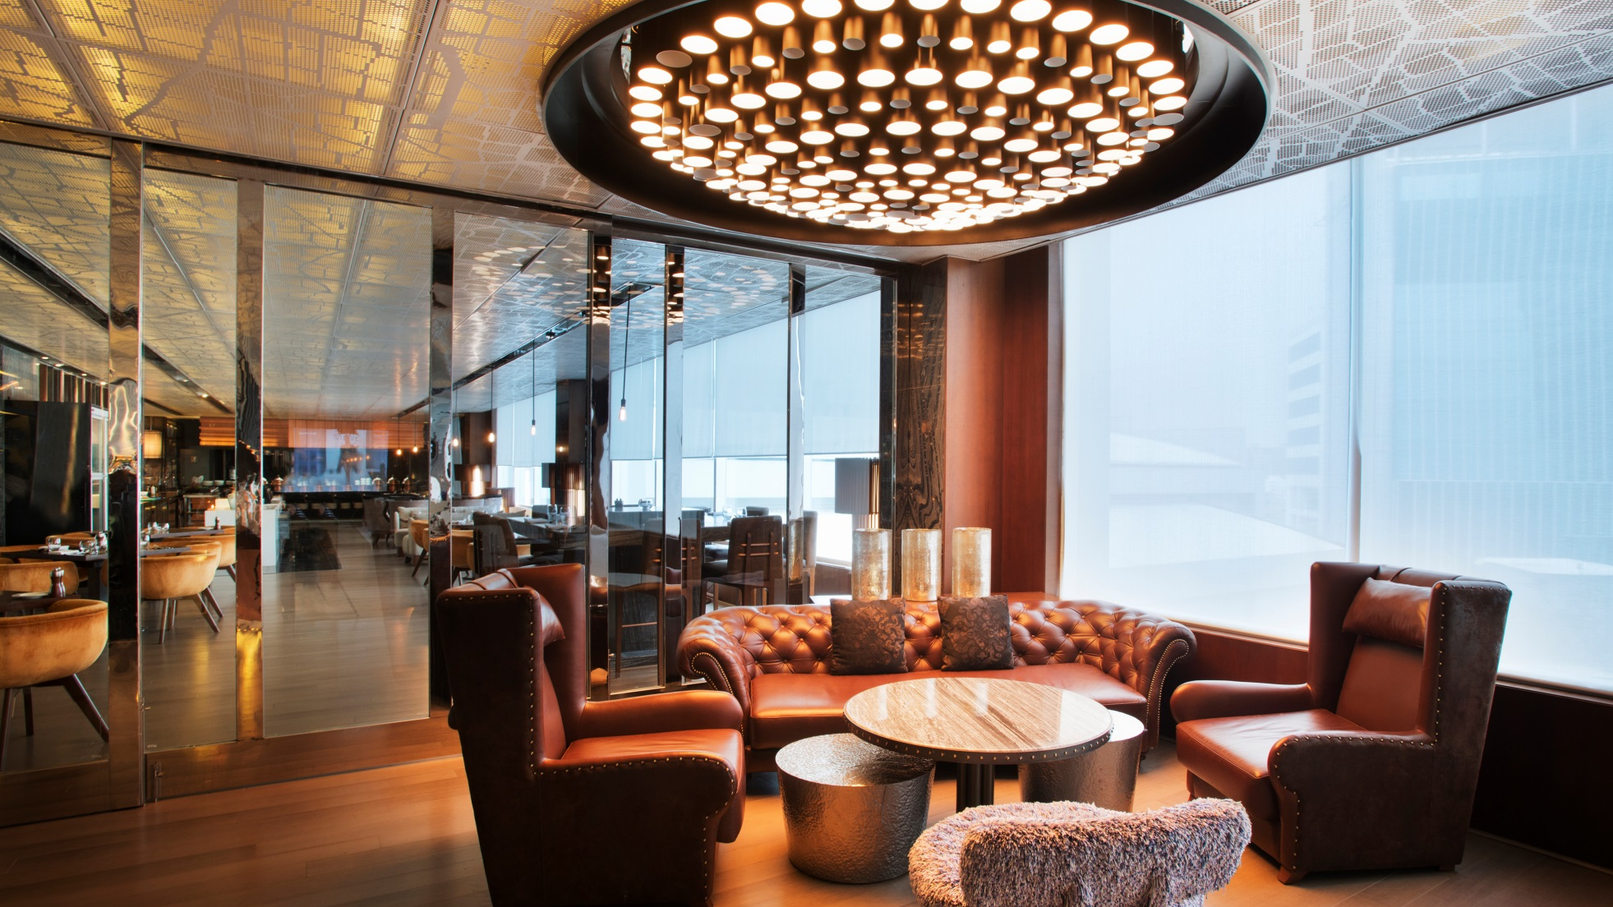
The Long Bar - A stylish and casual 60 feet long bar featuring an eclectic selection of the finest spirits, new and old world wines & a range of innovative cocktails created by the engaging and skilful bartenders.

Slide 26
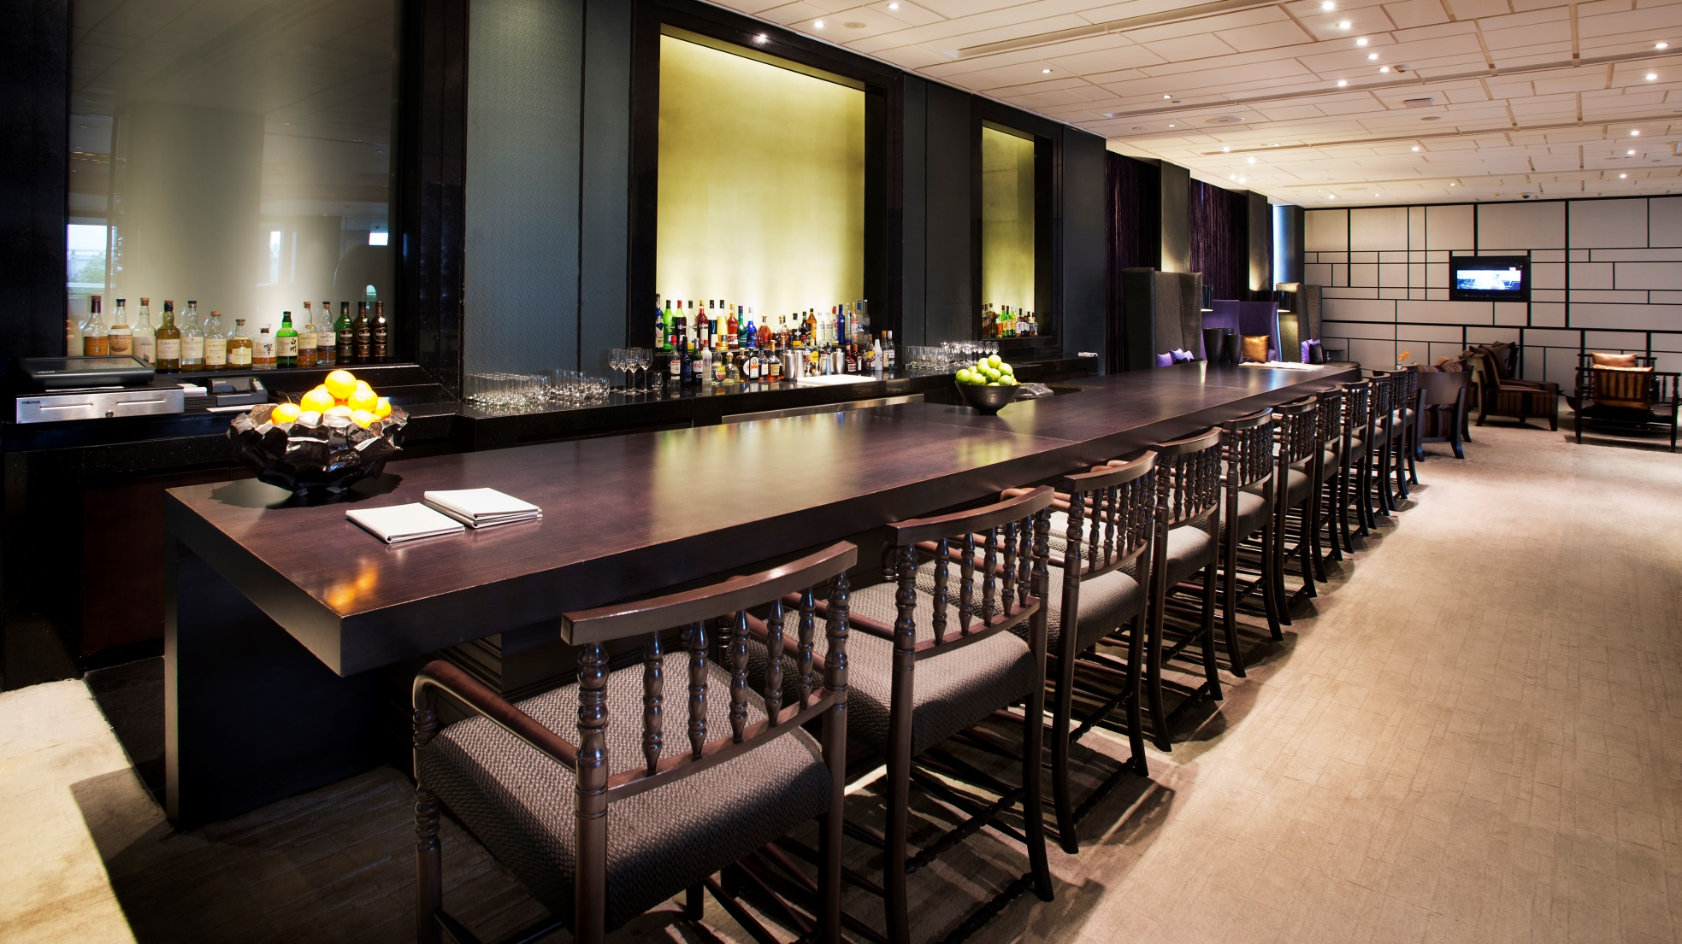
The Lounge - The Lounge is a comfortable environment for in house guests and visitors to convene & connect.

Slide 27
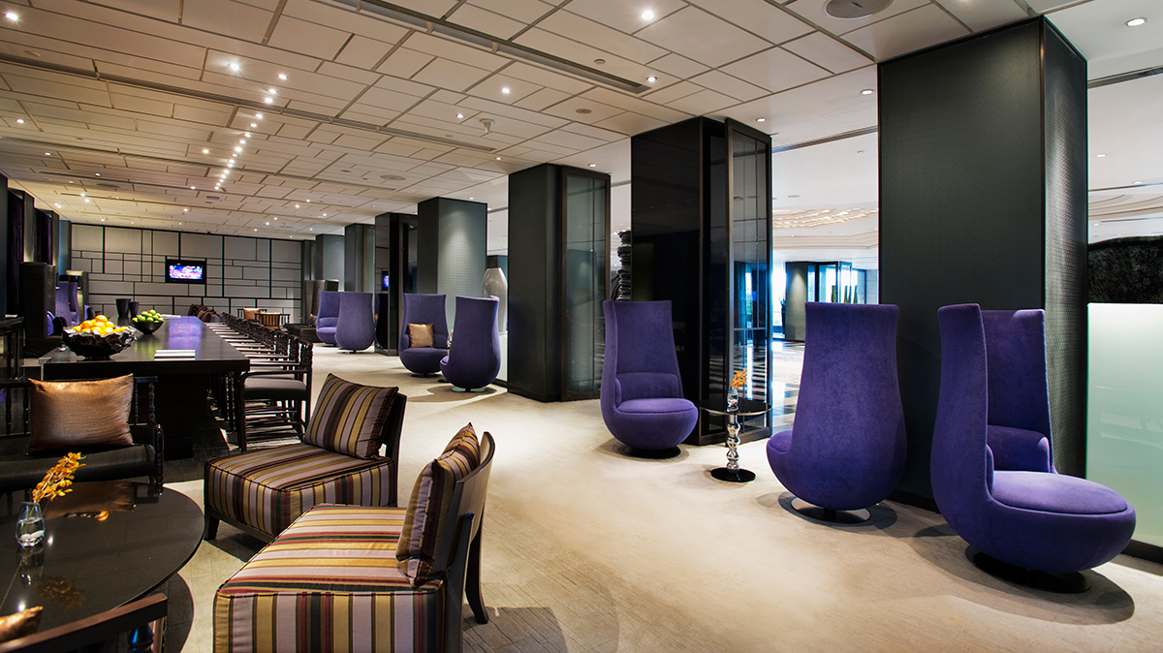
The Lounge - The Lounge is a comfortable environment for in house guests and visitors to convene & connect.

Slide 28
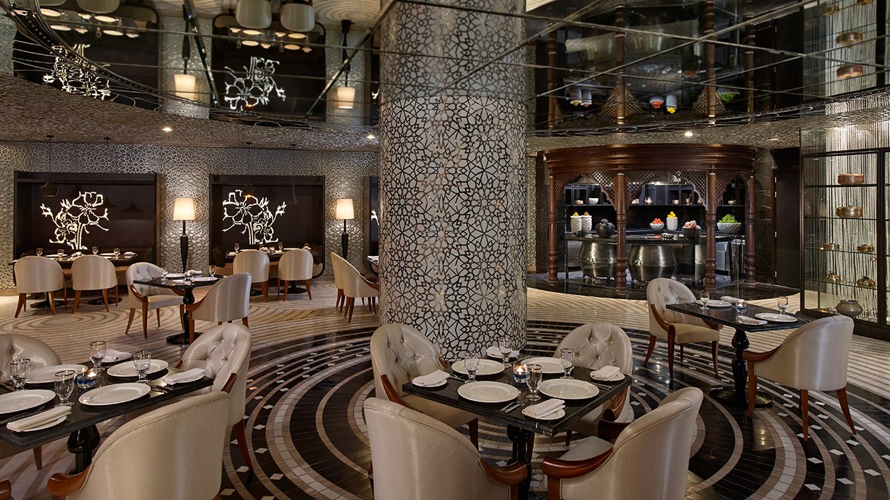
Lavana - Located on the first floor, Lavana serves authentic Awadhi cuisine & recreates the magic of the bygone Nawabi era with home style dishes.
Awarded “Best New Awadhi Restaurant” by Time Out Food Awards 2014

Slide 29
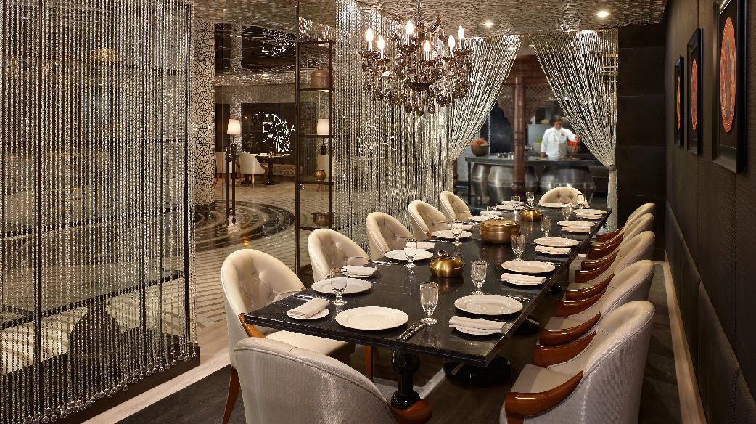
Lavana - Located on the first floor, Lavana serves authentic Awadhi cuisine & recreates the magic of the bygone Nawabi era with home style dishes.
Awarded “Best New Awadhi Restaurant“ by Time Out Food Awards 2014

Slide 30
MEETING &
EVENT
FACILITIES

Slide 31
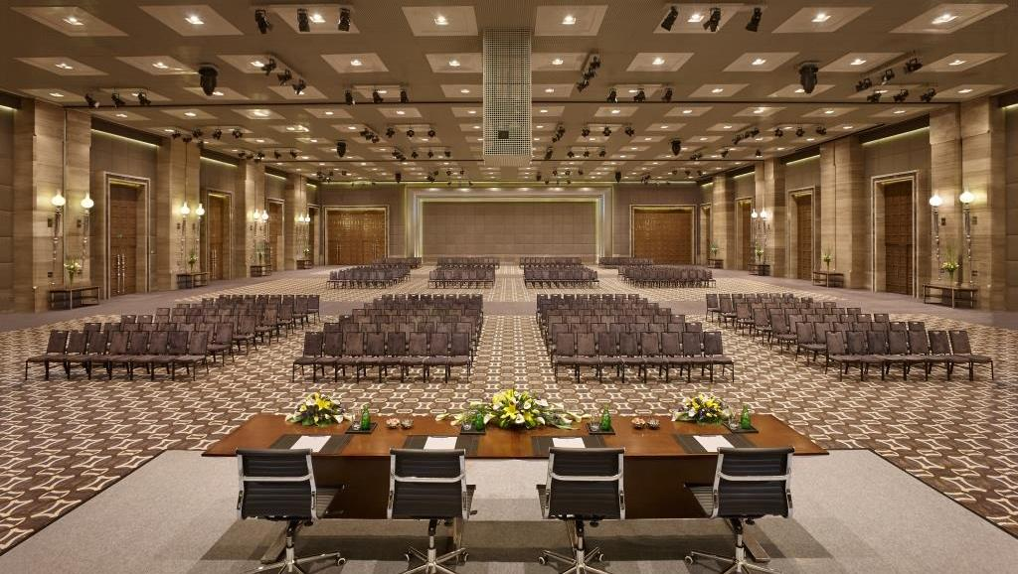
Regency Ballroom - Spread over 20,710 sq. ft. of area, with a majestic ceiling height of 28 ft.

Slide 32

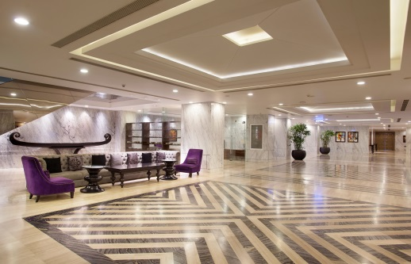
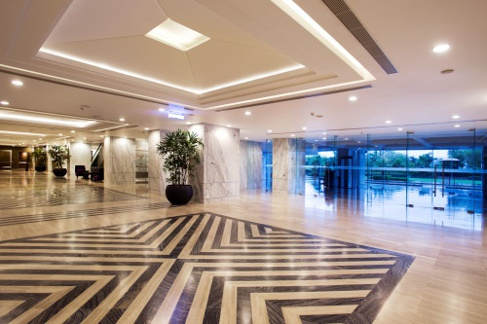
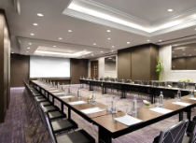
Conferences & Banquets
Largest convention space with more than 3,700 sqm (40,000 sq ft) of meeting event space
The magnificent pillar-less Regency Ballroom has an area of 20,710 sq. ft. and a majestic ceiling height of 28 ft. Built to accommodate up to 3,000 guests, the ballroom features the latest technology, surround sound system and conferencing facilities to provide an unparalleled audio-visual experience.
A total of 15 meeting venues which can accommodate anywhere between 4 - 400people
14,800 sq ft of versatile pre-function areas
Exclusive cargo access and two dedicated separate entrances
To facilitate your event, meeting aids and technical assistance are available, which include an impressive inventory of state-of-the-art equipment for high-speed Internet access and video conferencing
Dedicated Event Planning Team.
Innovative menus with live cooking options
Outdoor lawn for Gala dinners and themed evenings
Ability to provide Out Door Catering for exclusive meetings and events

Slide 33
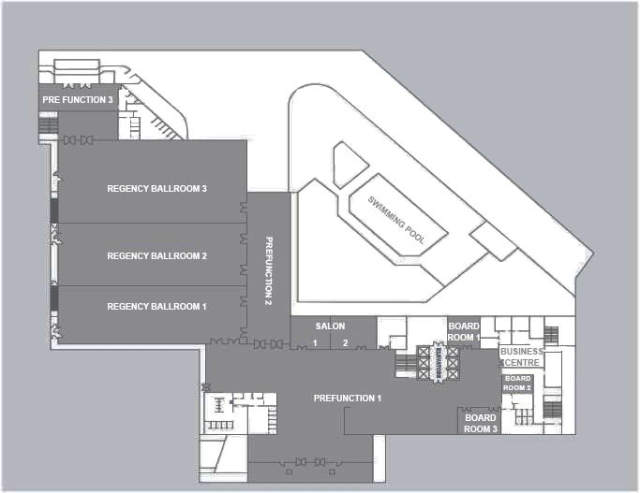
Layout of Conferences & Banquet facility

Slide 34
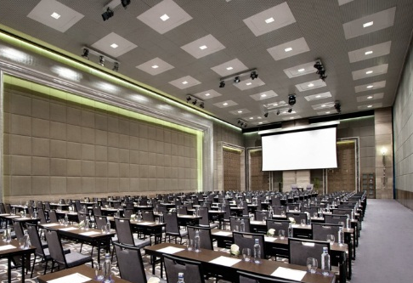
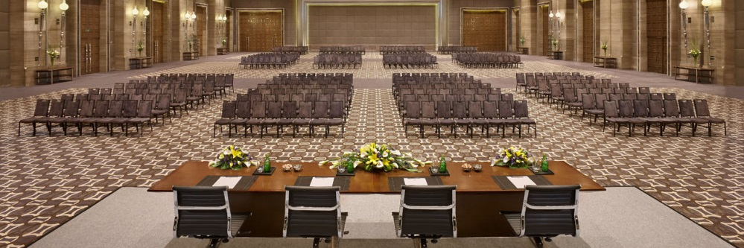
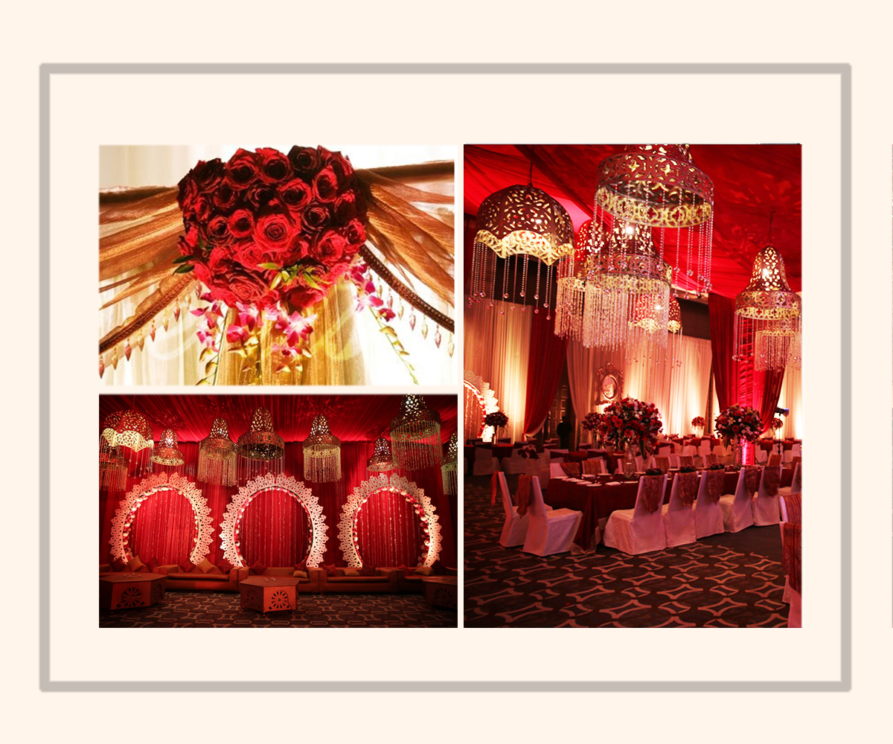
The Regency Ballroom :
20,710 sq feet with a clear ceiling height of 28 feet. It is pillar less and can be divided into 3 sound proof sections. It has two dedicated entrances and three flexible Pre-function areas. With state of the art technology, communication infrastructure and a dedicated cargo entrance, the Ballroom is ideal to host large conferences, weddings, conventions and exhibitions
Pillar-less Regency Ballroom (1,936 sqm/ 20,710 sq ft) which can accommodate up to 3000 guests theatre style with a clear ceiling height of 28 ft. It is also divisible into 3 sound proof sections to cater to smaller events, like weddings, parties etc.
Dedicated Pre-function area
It is the only ballroom in the country to house an in-built Christie projector producing 35,000 lumens (Highest Lumens offered in native HD).
There are 144 inbuilt LED Par Cans and 8 Moving Heads at the Regency Ballroom

Slide 35
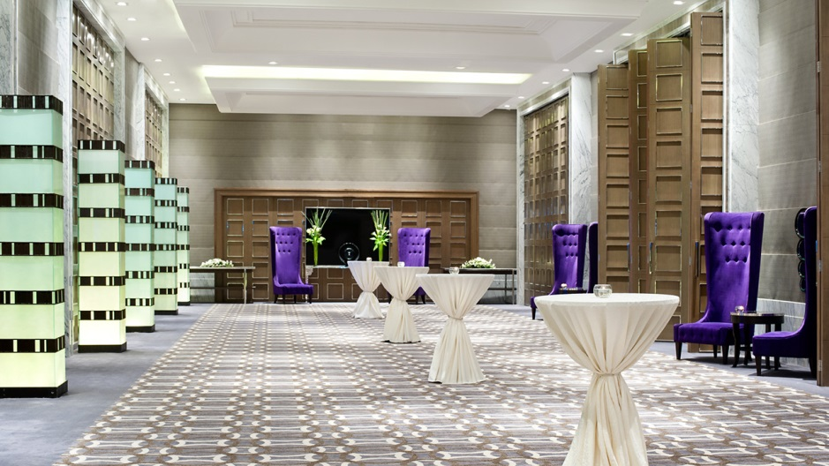
Events Pre-Function Area - The pool side is connected to one of the Ballroom pre-function areas to host gala dinners by the pool.

Slide 36

Events Pre-Function Area - Each section of the ballroom has its own pre-function area and separate entrance, in order to maintain the exclusivity of multiple events taking place simultaneously.

Slide 37

Events Pre-Function Area – Dedicated entrance to provide an impactful sense of arrival

Slide 38
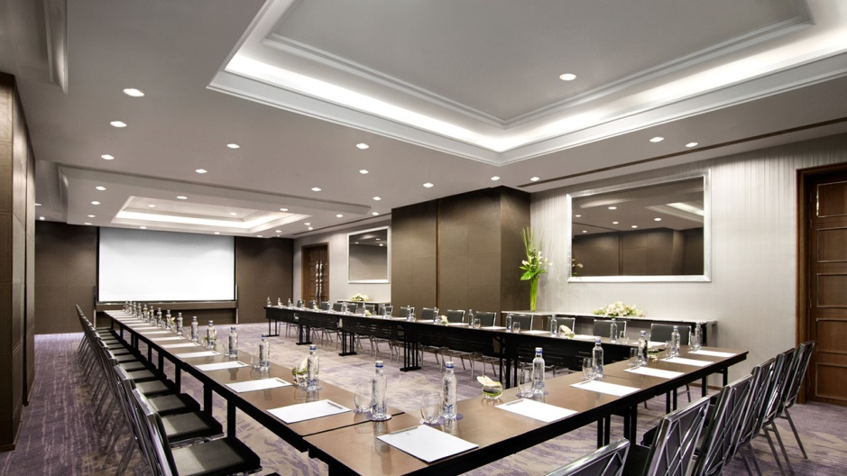
Regency Salon - 1268 square feet of meeting room divisible into two with In-built Data Projector and drop down screen.

Slide 39
WEDDINGS

Slide 40
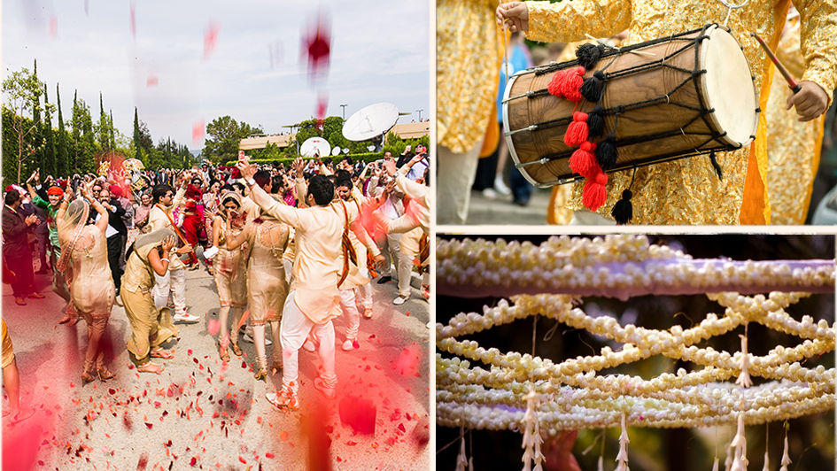
Dedicated entrance’s for receiving guests & marriage processions

Slide 41
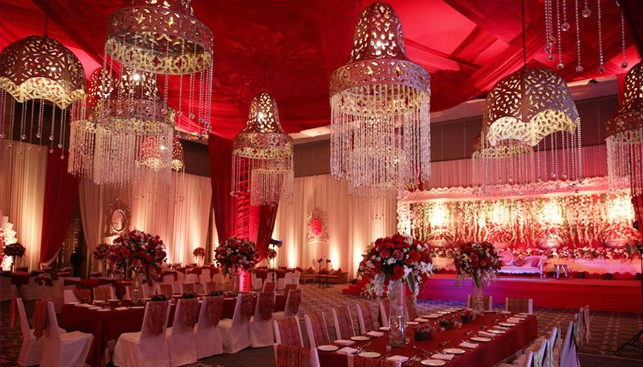
Enchanting décor and elaborate set-ups,

Slide 42
Exquisitely decorated wedding venues for ceremonies, receptions, morning-after brunches
or pre-wedding events

Slide 43
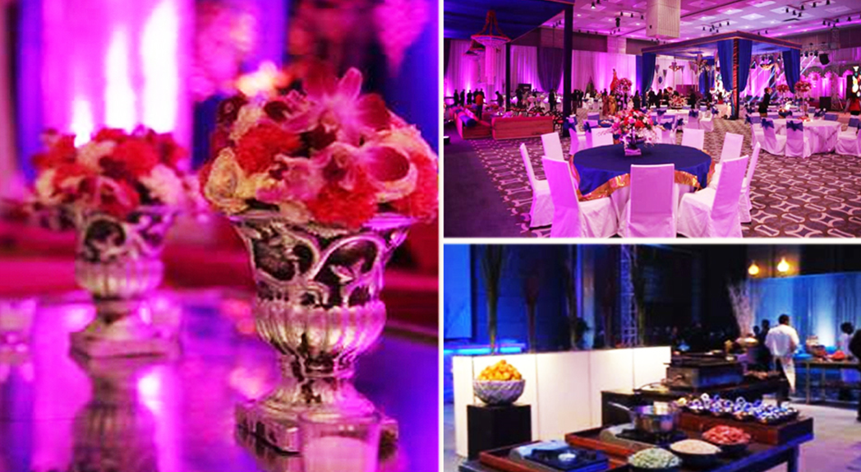
An exclusive panel of expert decorators to make the right recommendation for your wedding and work
closely with our in house planner to curate the perfect event,

Slide 44
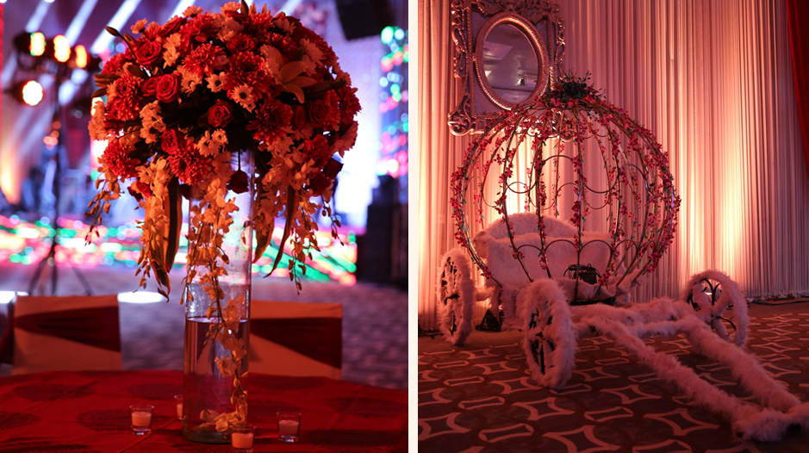

Slide 45
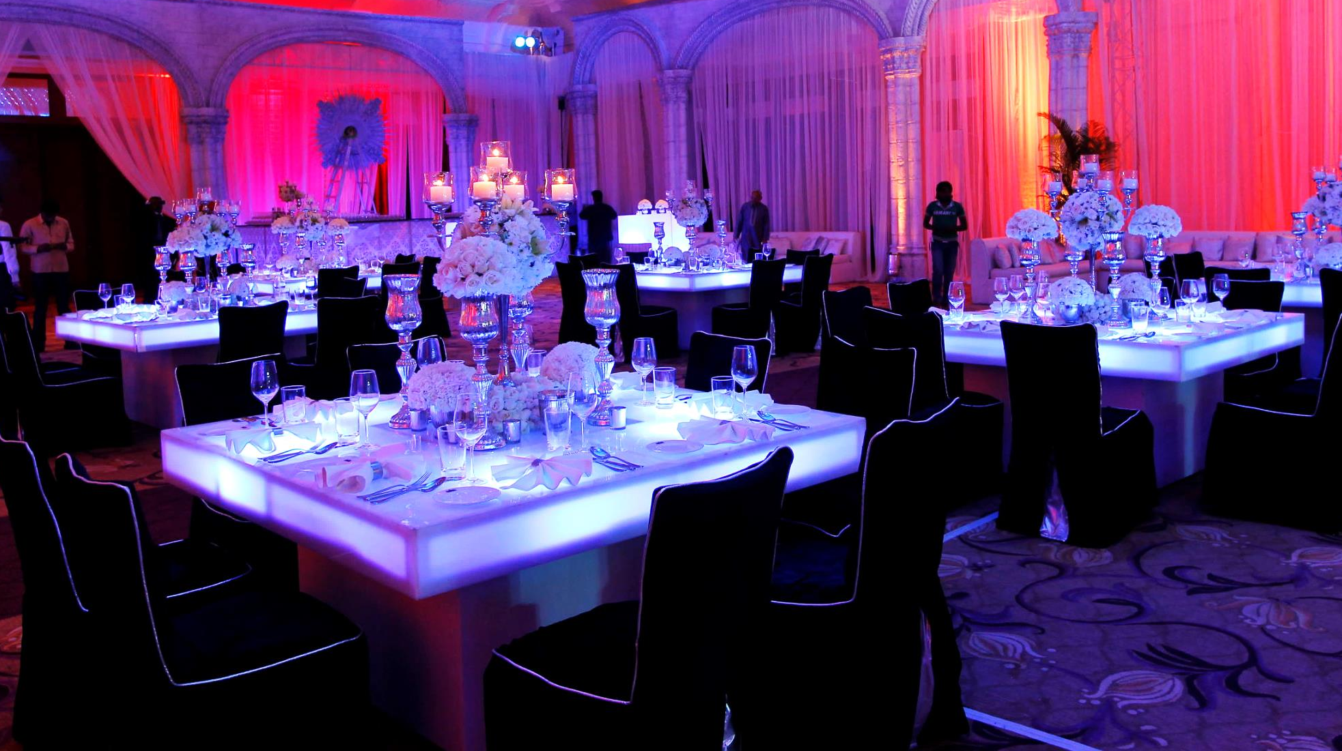
From an intimate pre wedding functions to reception for your family and friends, our array of elegant banquet facilities are perfect for the special day that you will cherish

Slide 46
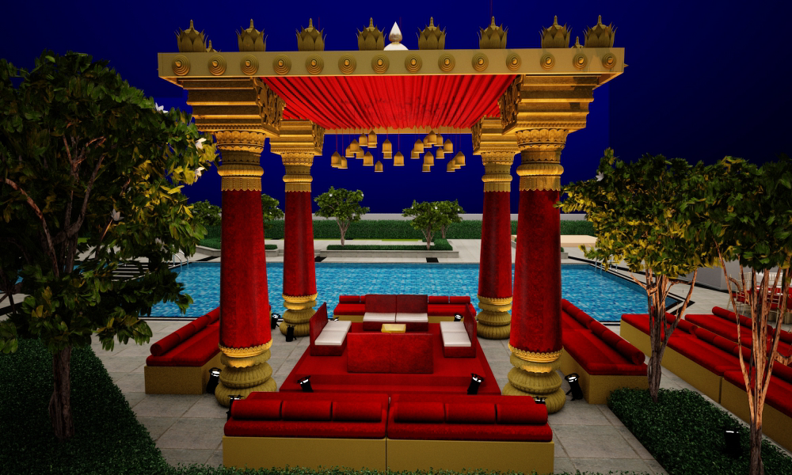
Arrangements for Vedi / Mandap by the pool side

Slide 47

Options for unlimited decoration & fitting options so as to create a harmonious confluence of the décor, colour scheme, selection of music, choice of flowers and all other elements by our partners HY 10 Experiences.

Slide 48

Intimate or grandeur, we provide bespoke gourmet catering for all occasions.

Slide 49

A Taste of Perfection – A wide array of menu options featuring Indian and international delicacies

Slide 50

Patisserie to provide a sinful array of sweet delights and a perfect Wedding cake.

Slide 51
RECREATIONAL
FACILITIES

Slide 52




Shvasa Spa
Offering a touch of tranquil heaven, far away from the hustle and bustle of the city, The Shvasa Spa offers an array of luxury spa treatments for your well being. Our extensive day spa menu includes Full Body Massage, Body Scrubs, Body Wraps, Manicure and Pedicure and Facials.
The Fitness Centre
Our Fitness Centre has state-of-the-art cardio equipment, weight machines and free weights to ensure a good work out. Personal trainers are available to guide you through your routine. You can also relax by the outdoor swimming pool that offers refreshing beverages.
Outdoor Swimming Pool & Kids Pool
Rejuvenate your mind & body with a dip in our outdoor swimming pool. Take a leisurely break on the sun deck while you enjoy a refreshing beverages. We also have a kids pool where kids can splash around.
Weekend activities & games for kids 20 feet rock wall, Zorbing, Bouncy castle, Toy Train, Trampoline, Mini golf putt, Dart, Hoopla, Glass pyramid, One art activity, Potter’s wheel etc.

Slide 53

Shvasa Spa - offers an array of luxury spa treatments for your wellbeing.

Slide 54

Fitness Centre-with state-of-the-art cardio equipment, weight machines and free weights to ensure a good work out. Personal trainers are available to guide you through your routine.

Slide 55

Swimming Pool - Rejuvenate your mind and body with a dip in our outdoor swimming pool. Take a leisurely break on the sun deck and enjoy a refreshing beverage. There is a special kiddy pool for your kids to splash around.

Slide 56


Thank you

